Slide 1



Team DigiLab

Slide 2
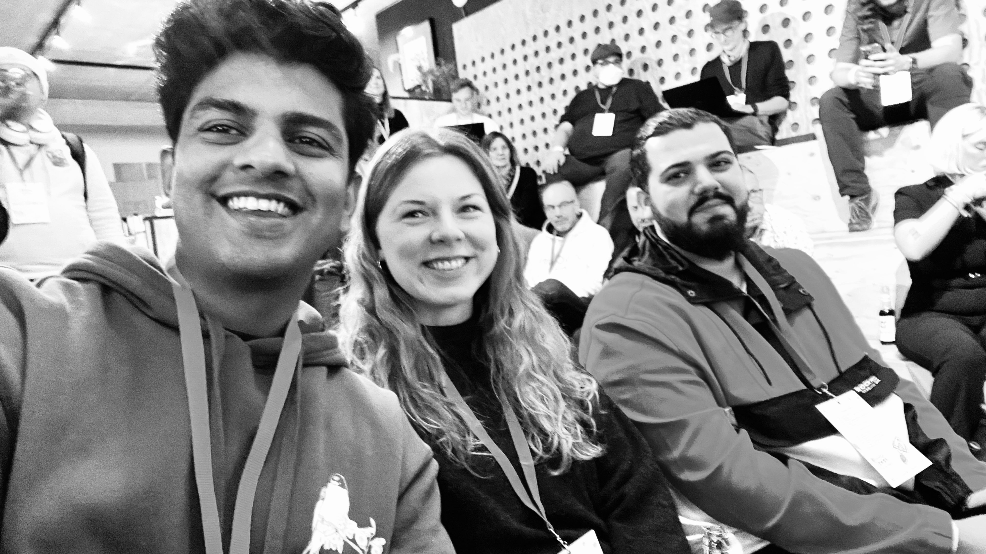
The Team
Nizam – AI Engineer
Sonia – UX Designer
Hossein – AI Engineer
Notes:
HOSSEIN

Slide 3
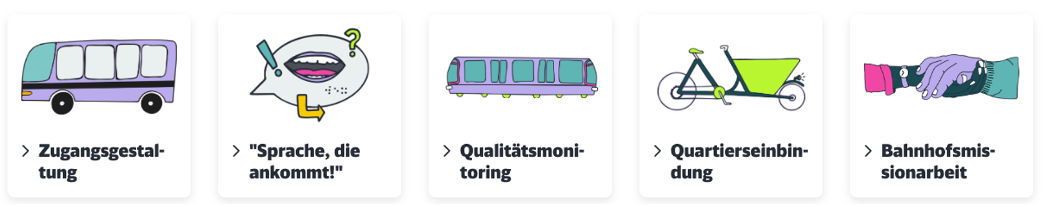
CHALLENGES
Notes:
HOSSEIN

Slide 4

Example: Traveling to the Hackathon
On the S-Bahn: Checking again the hvv App: bus is now AGAIN supposed to be on time
Running up to the busstation, but the bus is late as announced FIRST...
Where is Betahaus?
→ Checking Google Maps: 2 min from Altona Bahnhof Bahnstation to Altona Busstation
Checking again in Hvv app → 2 min bus delay, therefore one stop by S-Bahn to Altona Bahnhof
Going through to the end of the station (knowing where the stairs up to the bus station are)
Walking time = 10 min. to Altona station with a ‘fast walk‘, but heavy bag
Notes:
SONIA
Always late
Checking where betahaus is, because there is no option to find the place in hvv app -> switching to googel maps
2 options: walking 10 mins to altona bahnhof or driving 1 station from königstr. Zu altona Trainstation
Google maps: only
- Not possible to search for a special place or location like Betahouse -> therefore switching from hvv to google maps -> looking up in google maps the next bus or train stop

Slide 5

Notes:
SONIA

Slide 6
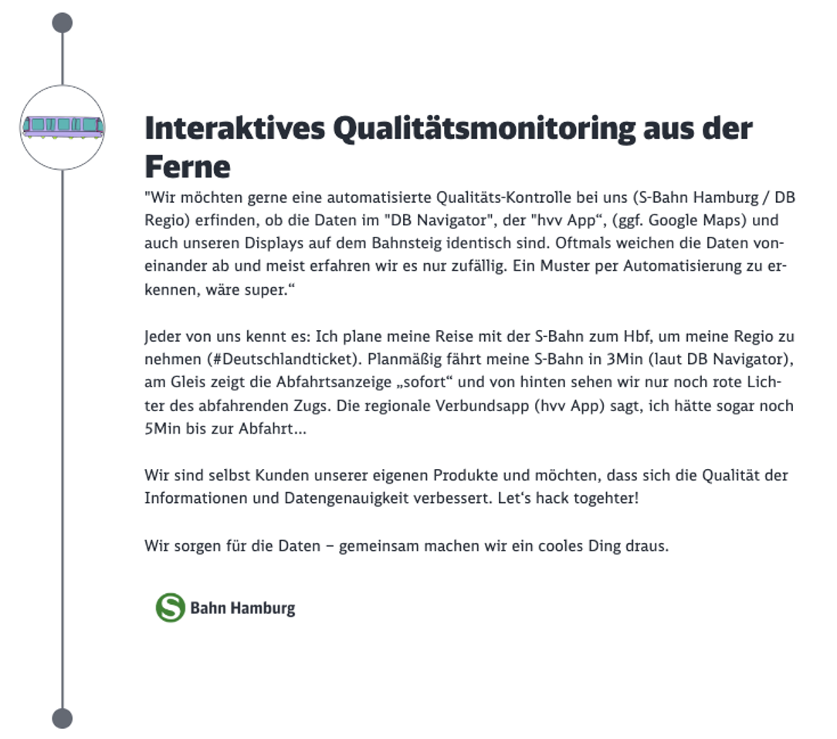
Notes:
HOSSEIN

Slide 7
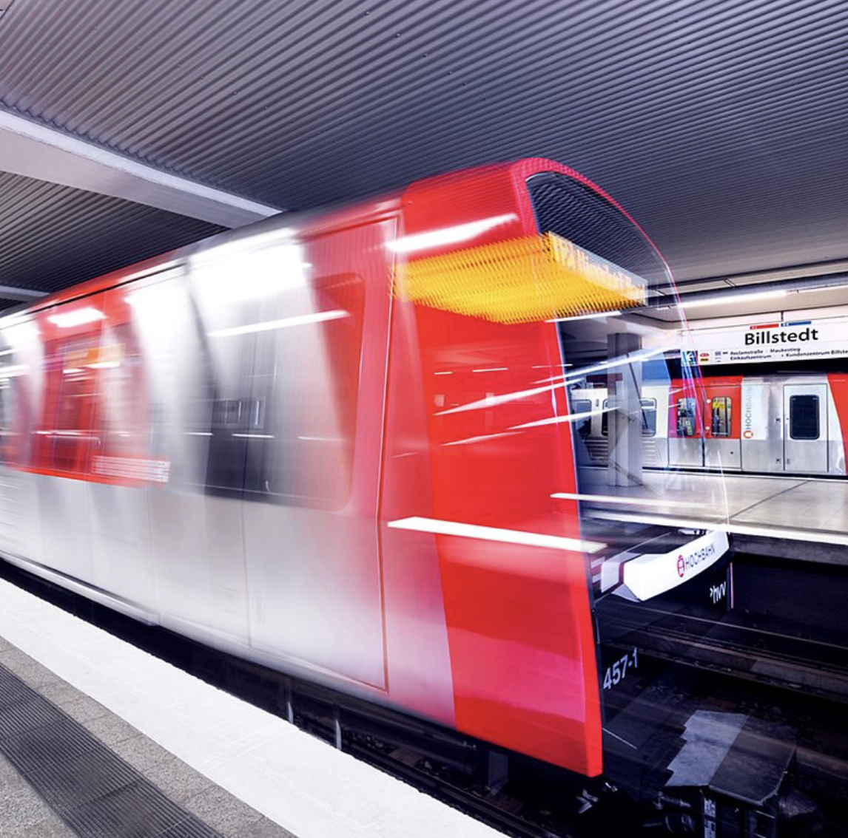
Problem:
Currently, different arrival and delay times of buses and trains are displayed in the individual apps (e.g. hvv, DB Navigator, Google Maps etc.) for one and the same connection.
Passengers are confused and/or annoyed because connections are missed
Public transportation is not perceived as reliable
Which app is correct about the delay time?
Notes:
Skipping, just summary
Main Problem = the challenge, but after talking to DB, hearing about google maps talk -> deeper problem

Slide 8



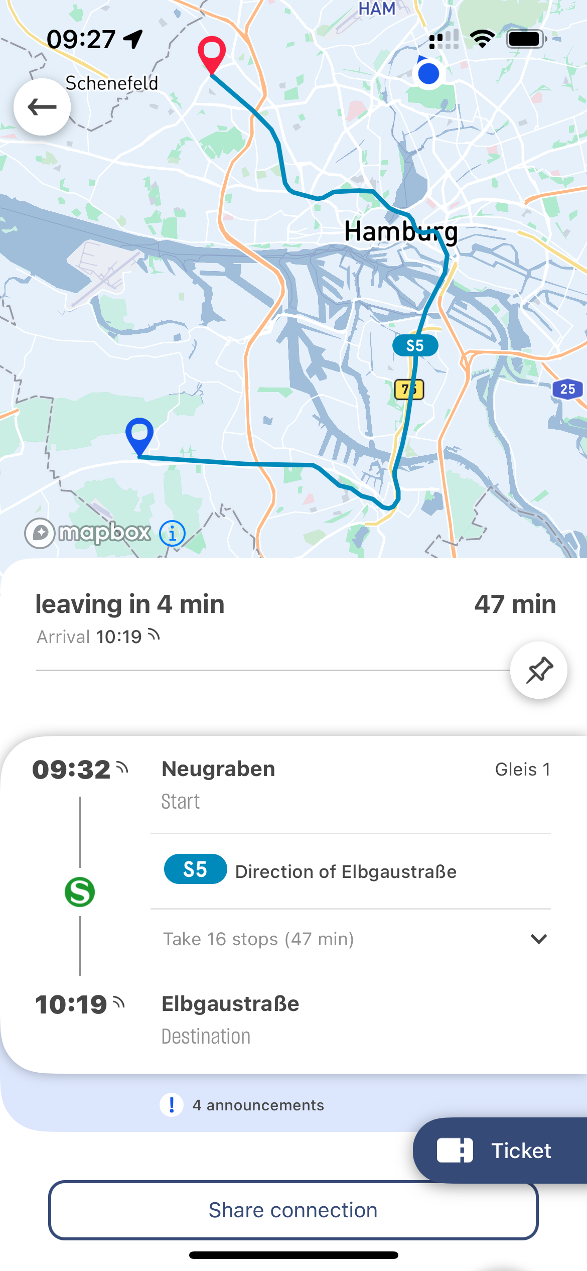
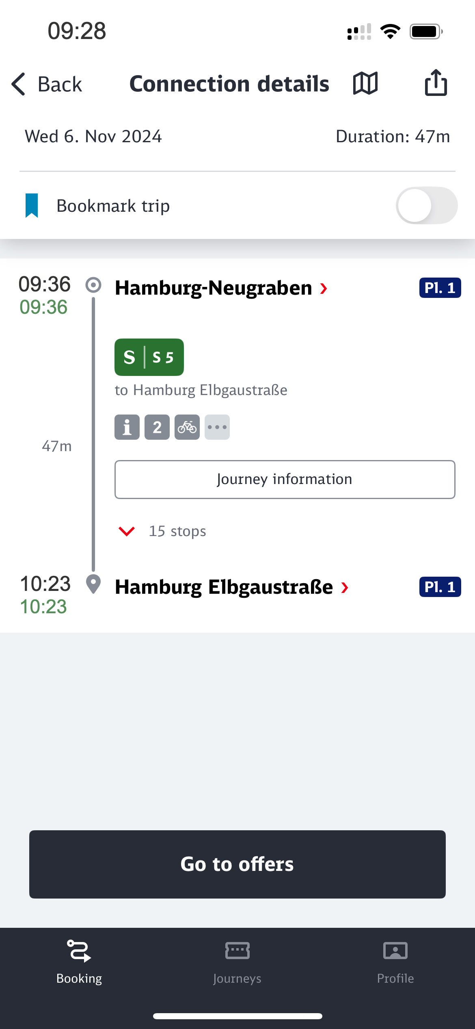
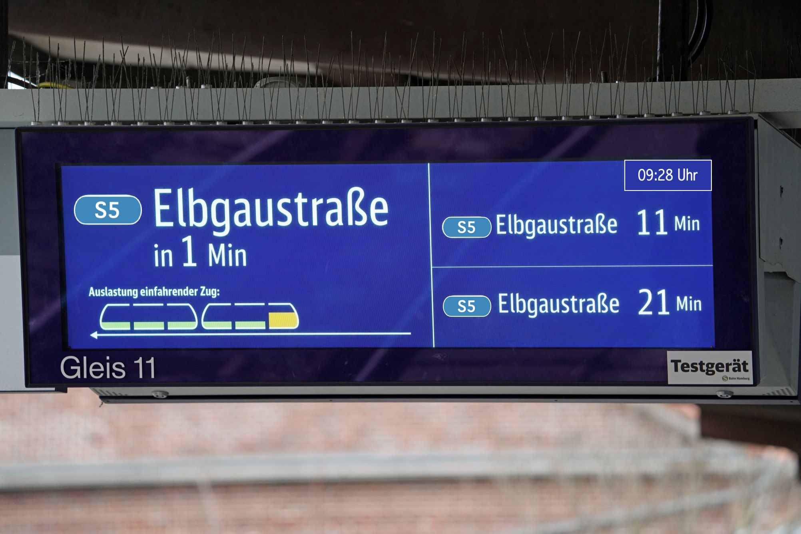
9:32
0 mins
9:36
+4 mins
9:28
-4 mins
Notes:
HOSSEIN
VBN = Data Hub

Slide 9
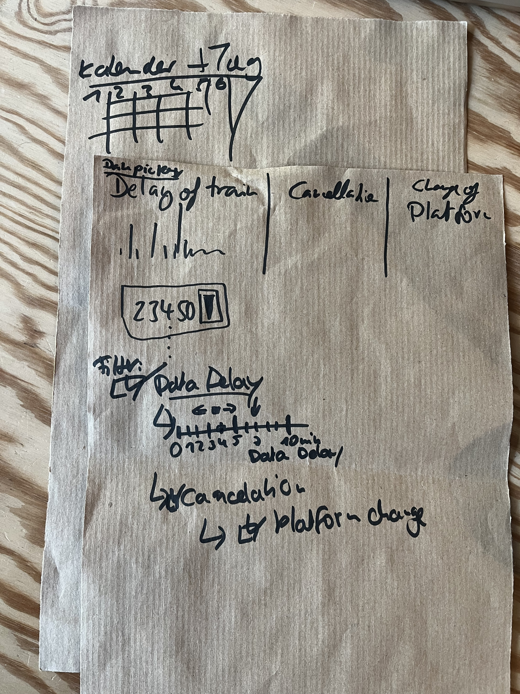
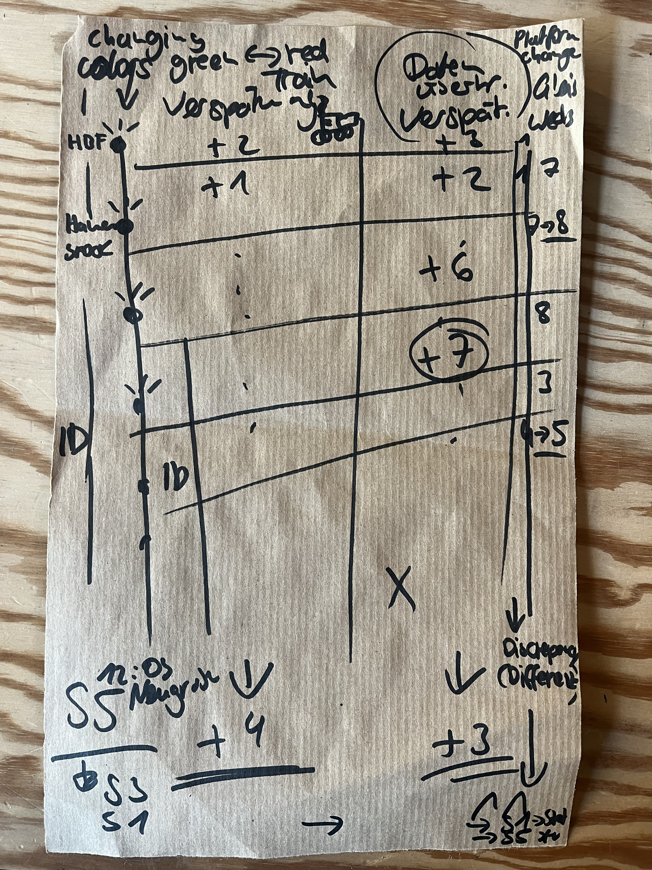
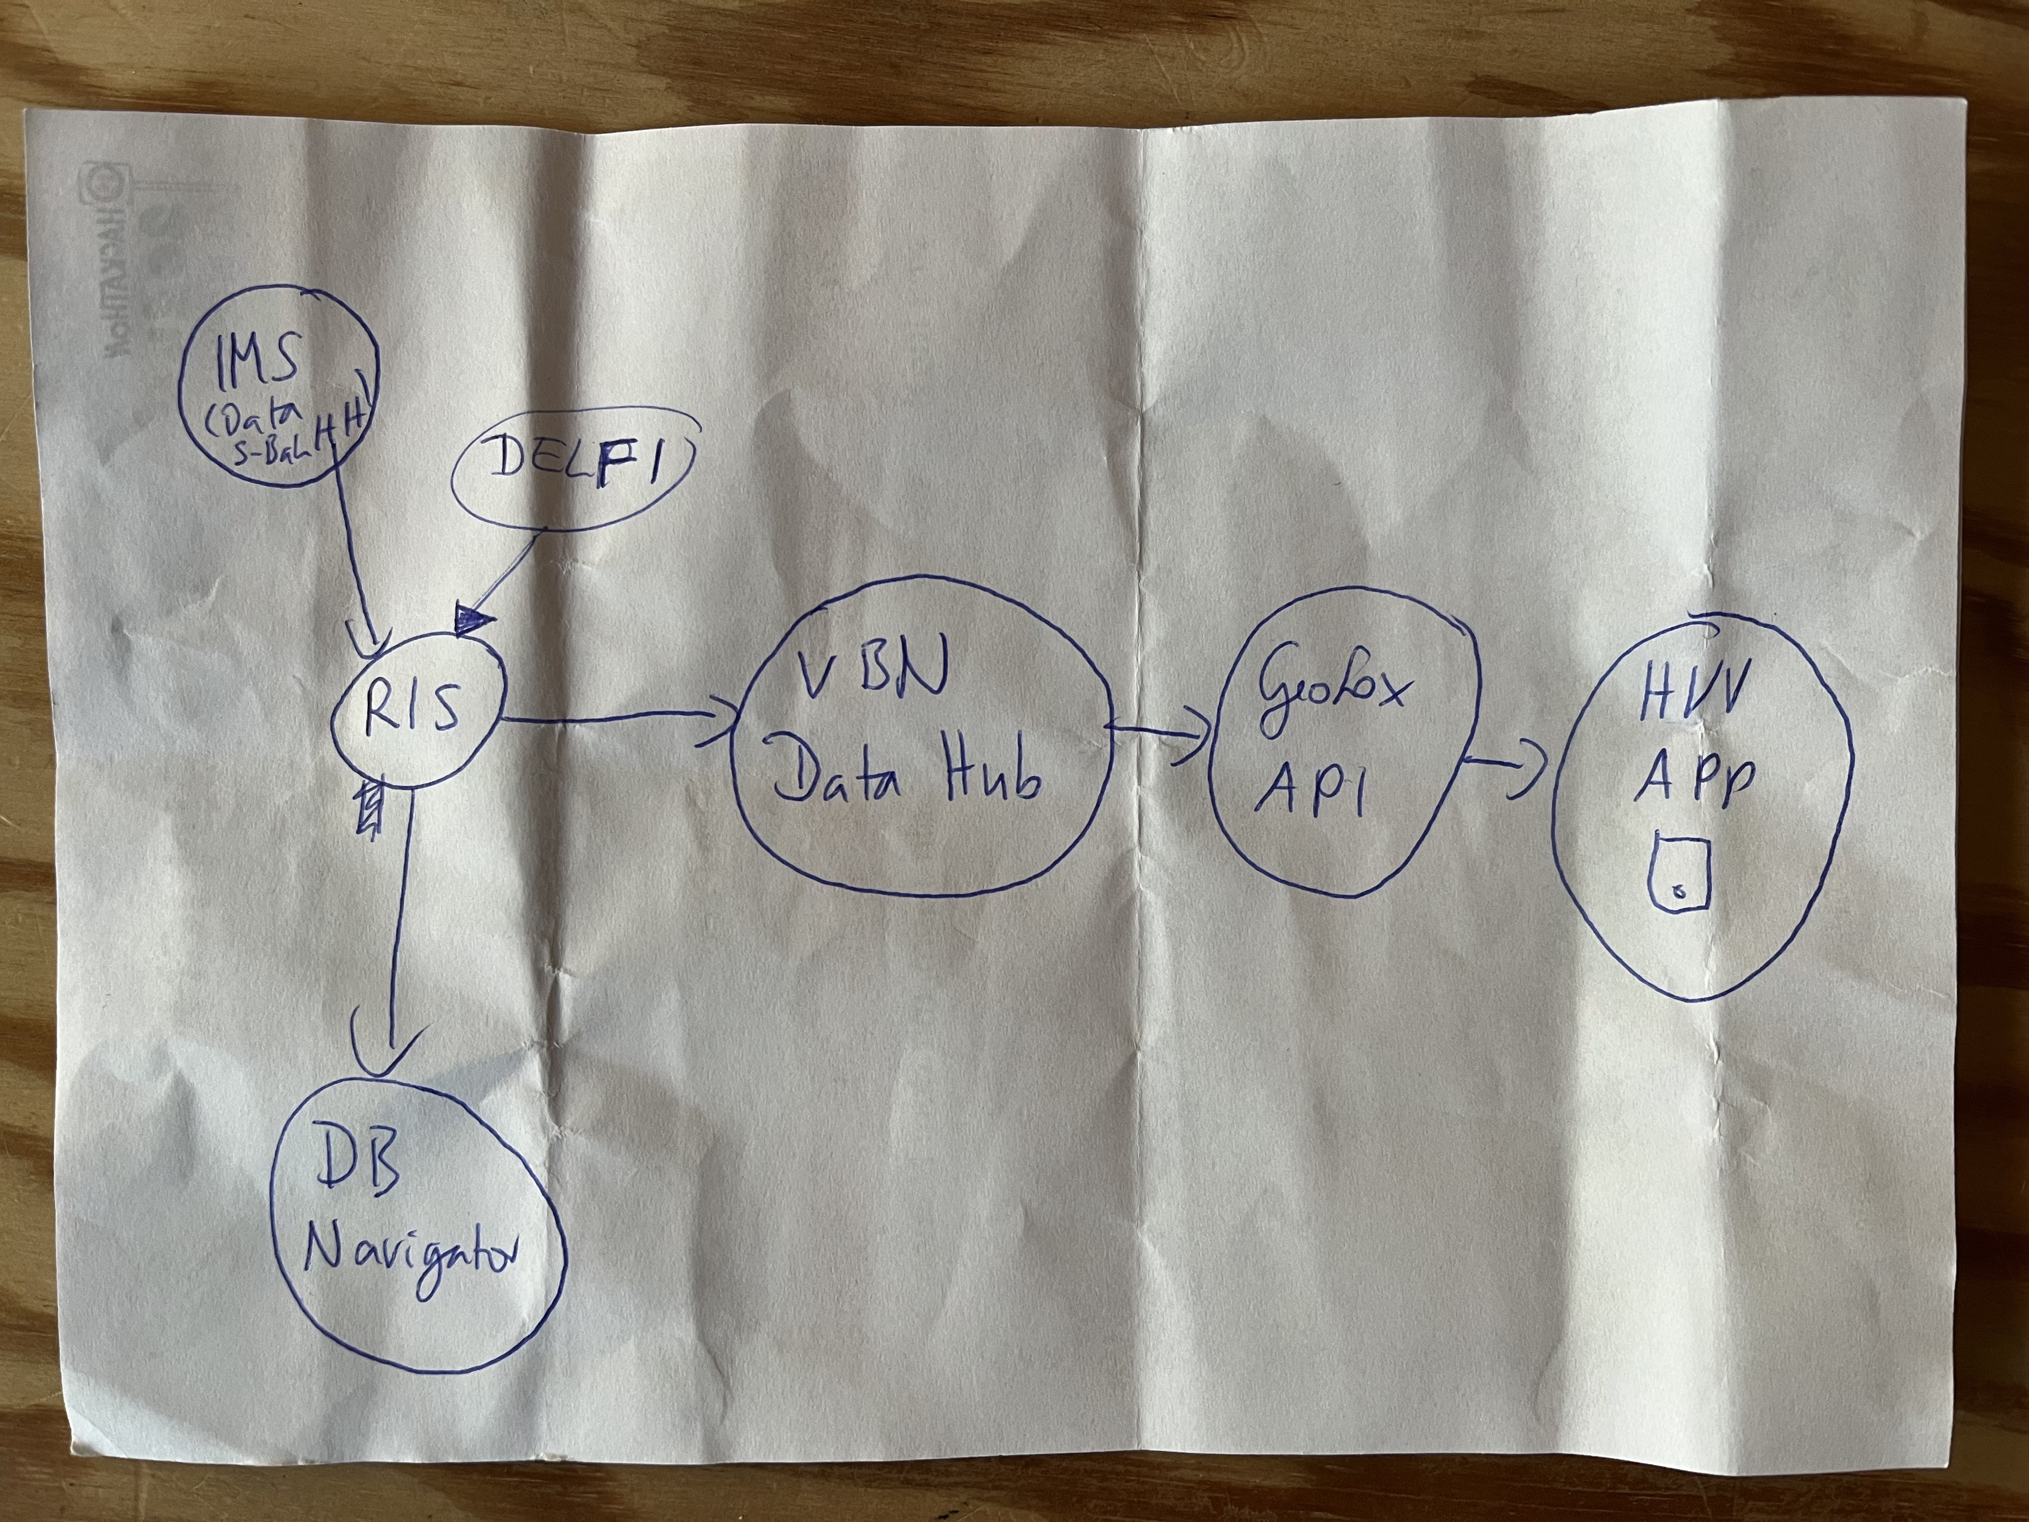
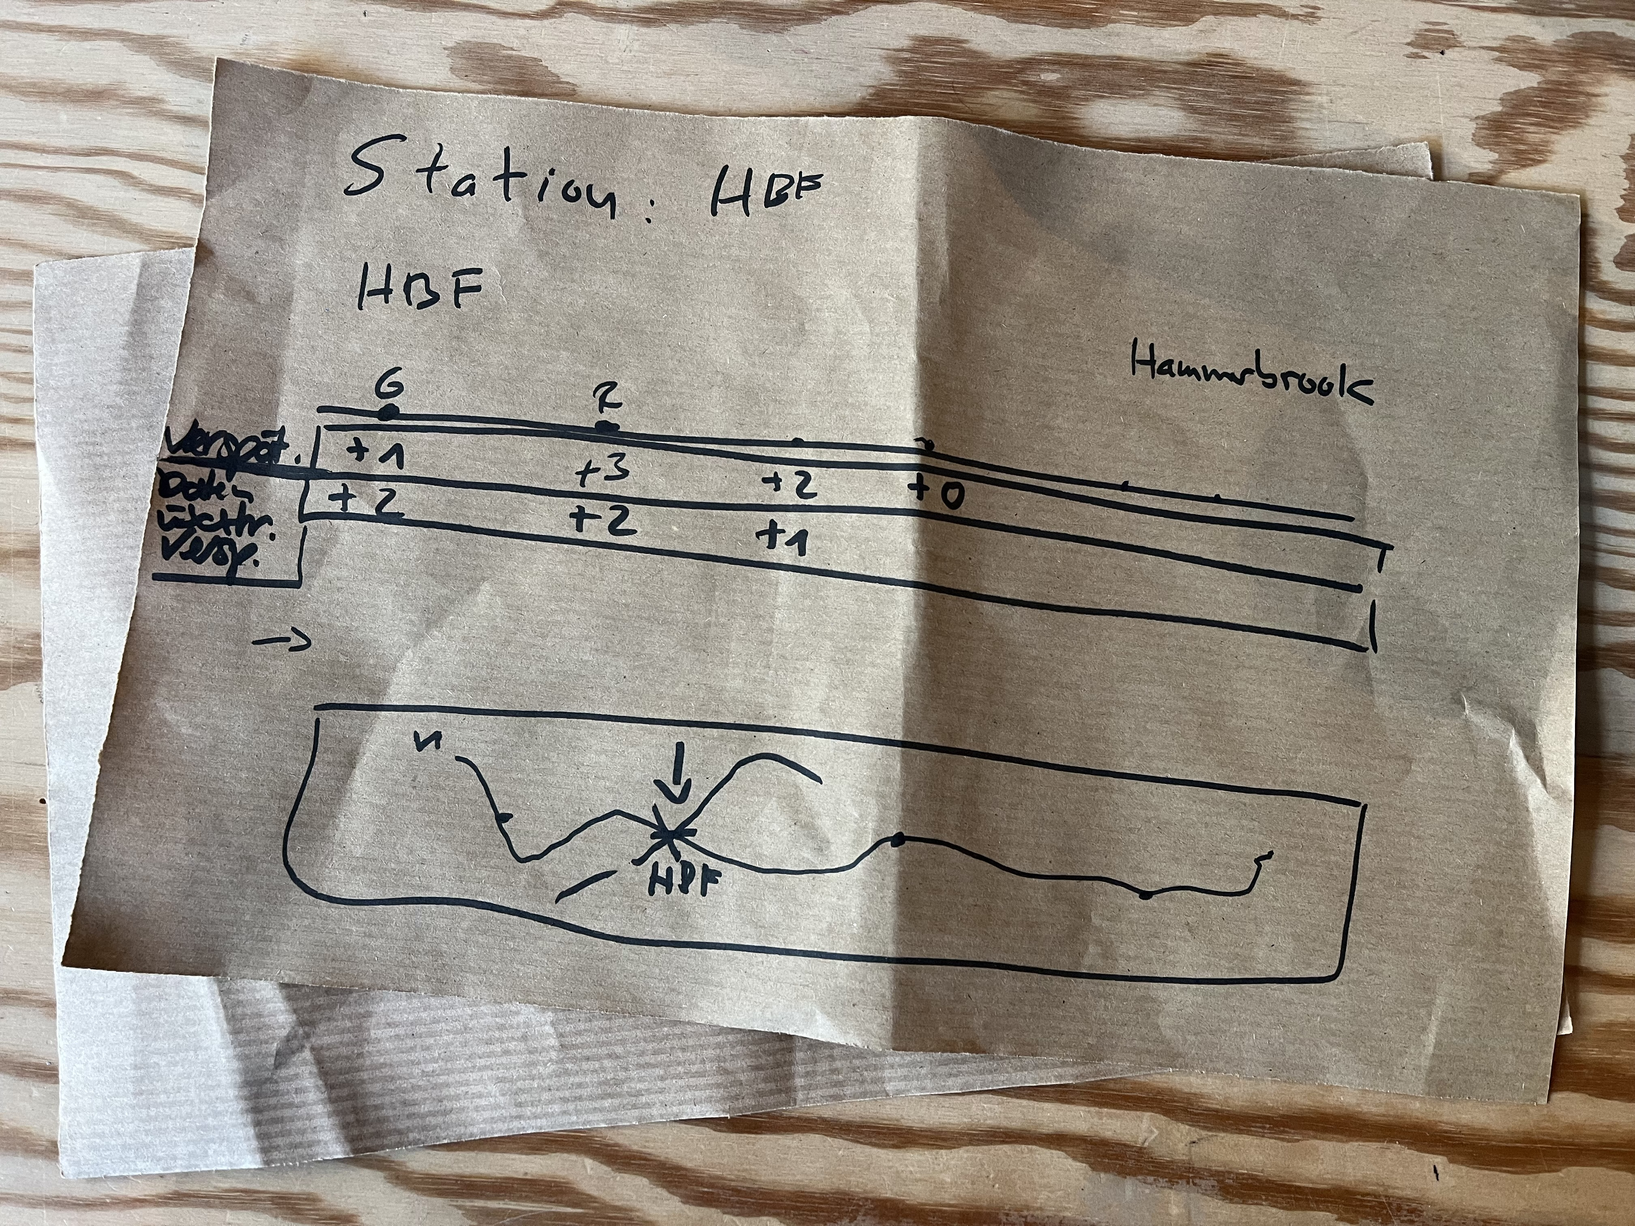
JOURNEY
Notes:
NIZAM
- To find the root cause of the problem
– had a long discussions with DB, GeoFOX, S-Bahn guys to get an overview of the data architecture.
We wanted to exactly find out how the data is flowing between these apps (DB, HVV etc)
During this step we experienced “SBahn“ blaming “DB“ and vice versa

Slide 10
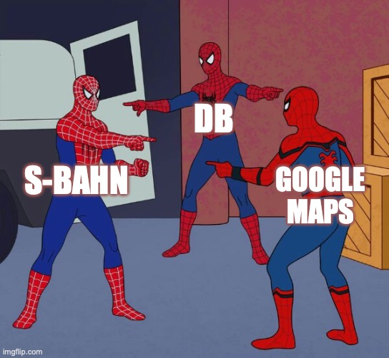
Notes:
NIZAM
CONFUSING ARCHITECTURE AND DATA FLOW
VBN = Data Hub

Slide 11

BEHIND THE SCENE (DATA FLOW)
Single source of truth
Geofox API
VBN
Digital
Display Boards
GATEWAY
RIS
RIS - API
DB – Backend Cached
GATEWAY
Notes:
NIZAM
VBN = Data Hub
RIS = Reisende Informationen System
GeoFox API - main source for HVV timetable
From “Source“ to “Destination“, the original data goes through different gateways
Our assumtion is that, the data might get delayed / curropt during these process

Slide 12
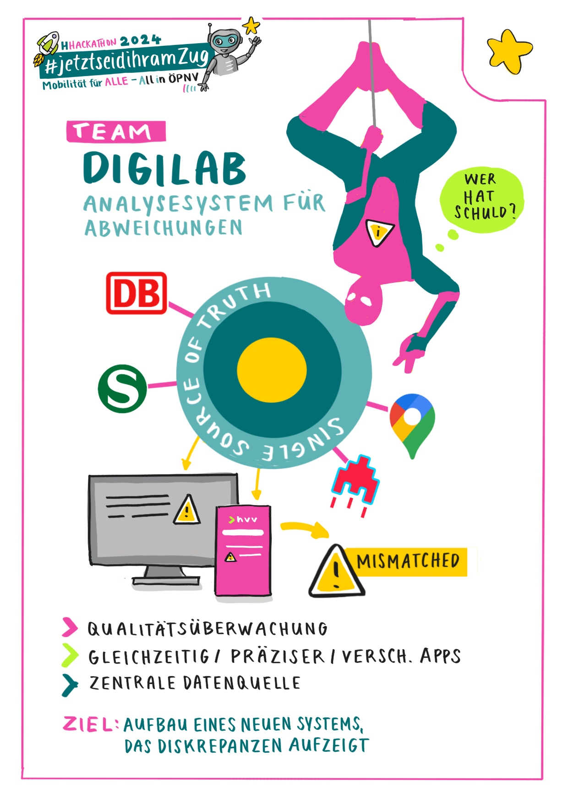



PROTOTYPE 1 “REALTIME QUALITY MONITORING ALERT SYSTEM”
Notes:
NIZAM
Why „Quality Monitoring System“ ??
- S-Bahn heard that there is TIMETABLE missmatch in different apps, but they haven‘t check and they dont have any ystem in place to give them this information.
- This platform will alert them if there is miss match between HVV app vs DB/Google Maps/Digital Displays

Slide 13
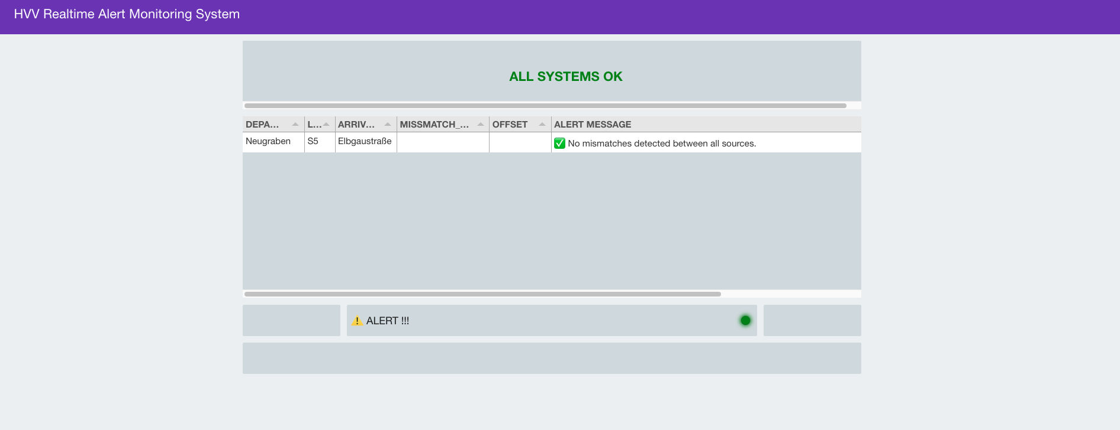
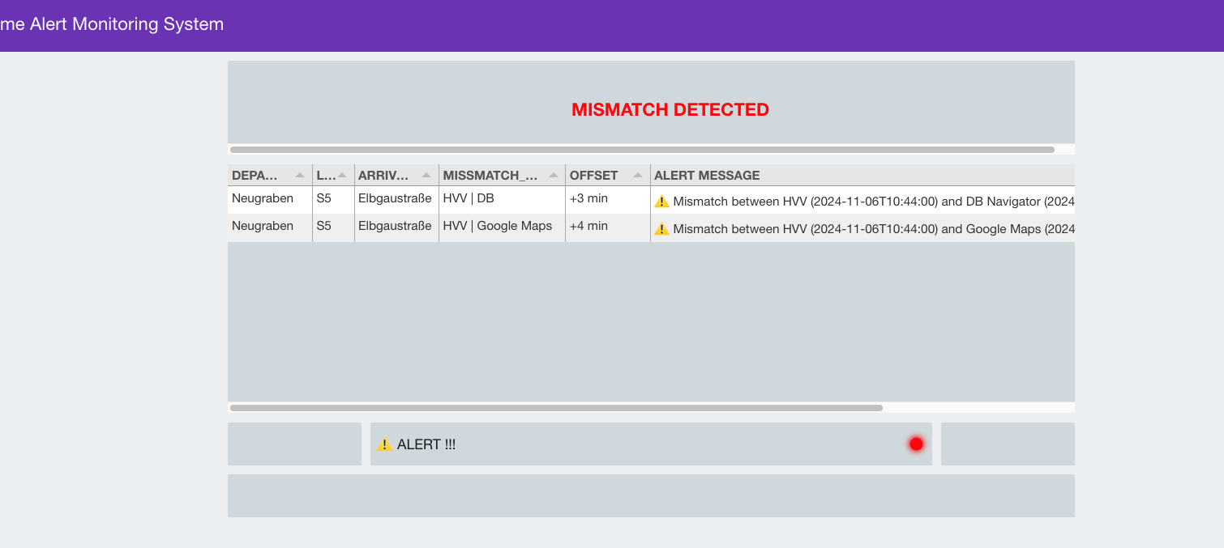
PROTOTYPE 1 “REALTIME QUALITY MONITORING ALERT SYSTEM”

Slide 14
Our Journey & Workflow
User research with DB & S-Bahn:
→ What is especially useful for S-Bahn employees while using the dashboard?
→ Which functions would you like to see?
How should it be designed?
Example:
→ Vertical display, as already known from other portals at S-Bahn
→ Filter functions for better overview and statistical purposes
Notes:
Skipping quickly

Slide 15
PROTOTYPE - 1
DEMO
Notes:
NIZAM DEMO

Slide 16
PROTOTYPE – 2
S-Bahn DELAY DASHBOARD
DEMO
Notes:
HOSSEIN DEMO

Slide 17
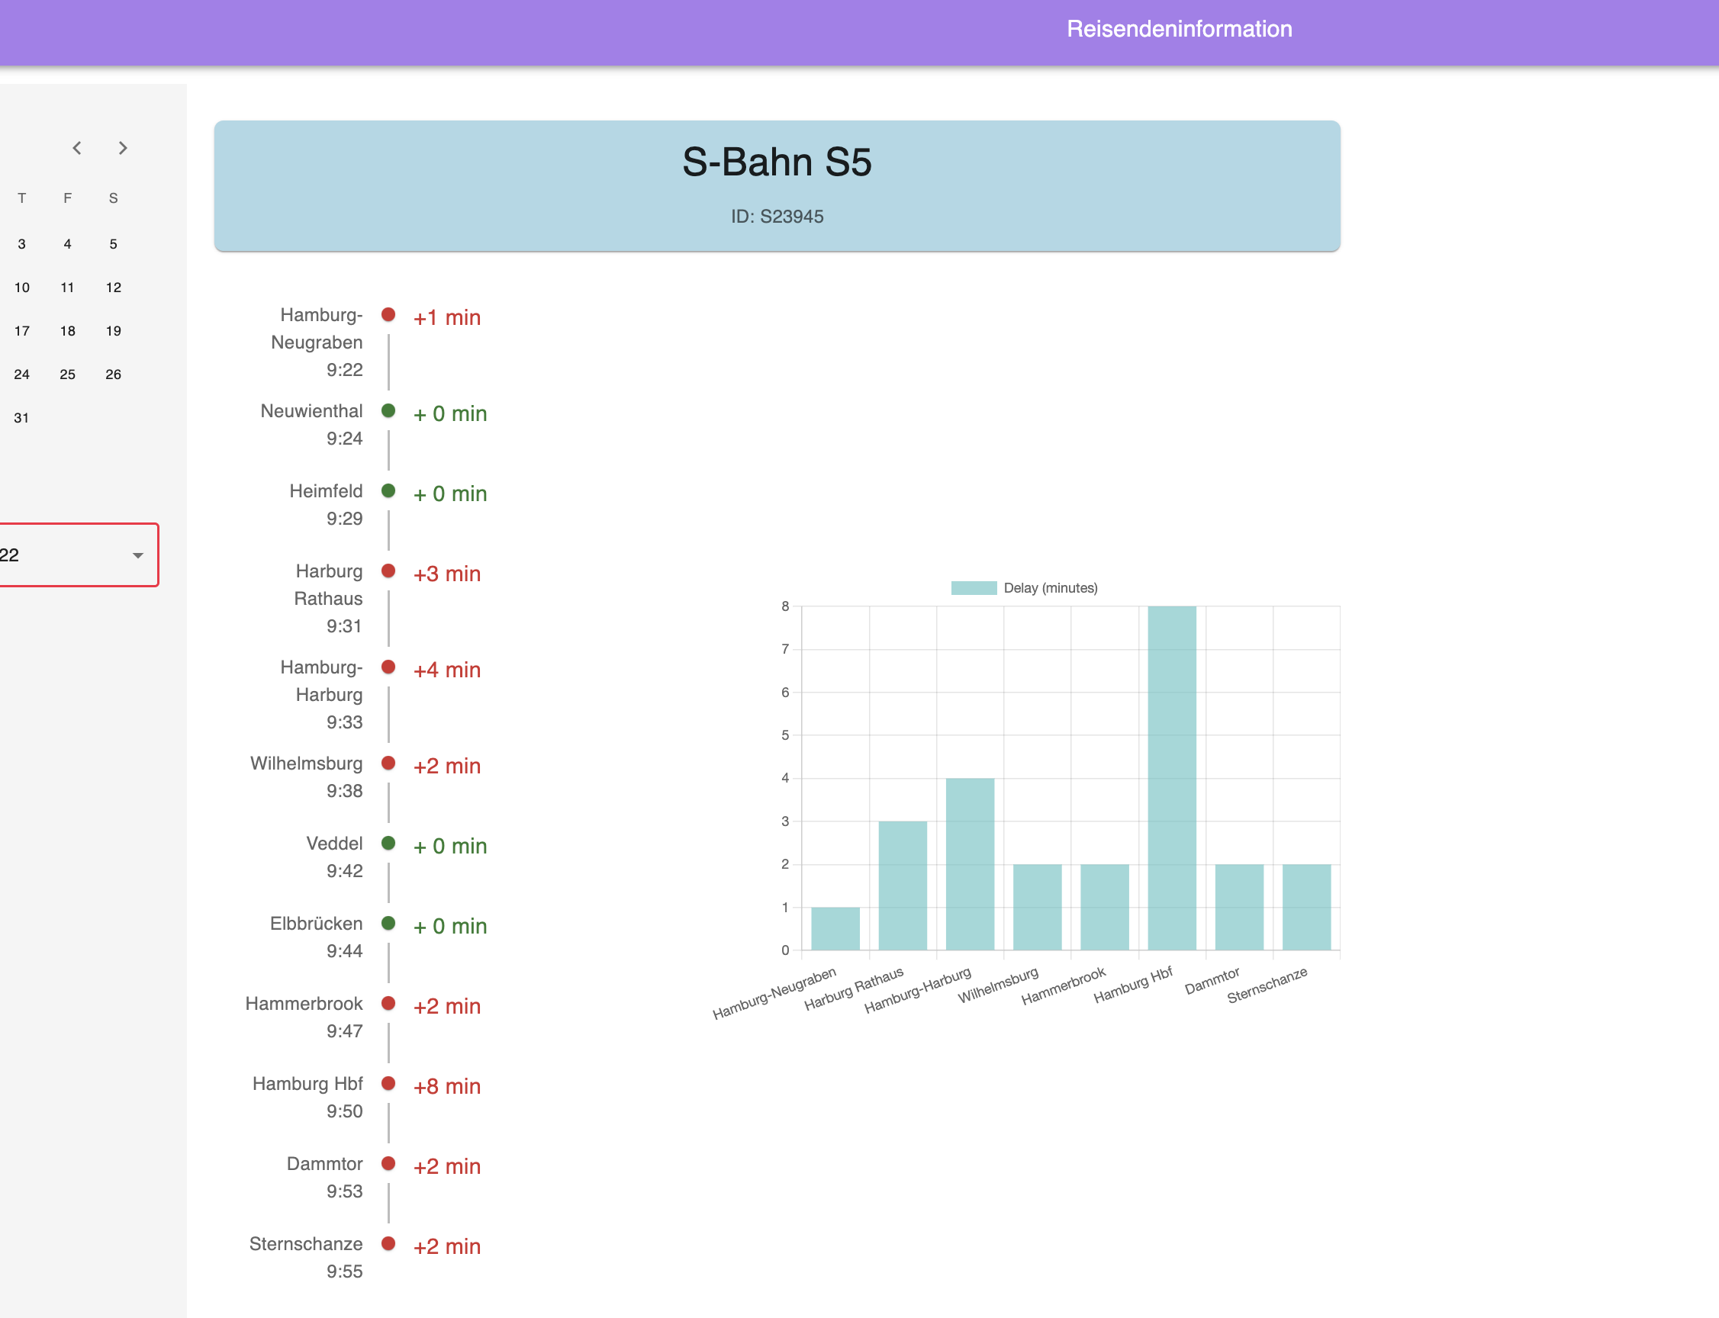
PROTOTYPE – 2
S-Bahn DELAY DASHBOARD
DEMO
Notes:
HOSSEIN DEMO

Slide 18
Our Approach
How can our product help in public transport / ÖPNV?
→ The platform could help to identify the discrepancies between the delay times, which would in the end especially benefit the final user
Can rely on all apps speaking “the same language”, regardless of whether hvv, DB Navigator or Google Maps is used
Which data was used?
Open Data: Geofox & RIS API Data was used
Can the project be continued?
The basis for error and delay analysis via the platform has been created and can be further developed
Notes:
HOSSEIN

Slide 19
Our Approach
Is it innovativ?
Not innovative, but desperately needed! As there is no standardized communication at the moment. Measured by DB, it is quote
“Super innovative if it could be automated to control the data”. :-)
What about accessibility?
Difficult in this project, as we created more or less a B2B platform/dashboard and do not have a user in the form of a passenger
Although color coding (red = delayed, green = on time) was still titled (in case of possible red-green weakness)
Dashboard could also be used with keyboard only (if person has less fine motor skills)
Notes:
HOSSEIN

Slide 20

Potential features for future development
S-Bahn communication:
When one S-Bahn is blocking another S-Bahn - but the timetable shows the other S-bahn is on its way
The blockage is not reported to DB Navigation App, hvv App etc.
Integration of communication inbetween S-Bahn trains
Google Maps:
Integration of realtime S-Bahn data
Comparing Data:
Statistical comparison between train delays and data transfer delays
Notes:
SONIA

Slide 21

Potential features for future development
HVV App:
Implementing geocode of the landmarks/POIs in searchfunction
For e.g.: Currently it‘s not possible to search for ‘katze‘ or ‘betahaus‘ directly in the search filed
→ Instead you always need a address like Eifflerstr. 43 or the nearest bus/train-station-name
→ Switching to google maps app to get the info
Walking distance calculation:
Implementing and comparing the walking distance calculation between platforms/stations in different apps (hvv, DB Navigator etc.) and also extend the DB Navigator App (currently only for station to station walking)
Notes:
SONIA

Slide 22

Learnings
Asking questions, asking more questions and then ask even more questions...
Not assumimg that the stakeholders know exactly what they want and need to solve their problem
Public transport in Germany, especially in Hamburg, is special and complicated
not assumimg that the data provided will also work. :-)
Notes:
SONIA

Slide 23


Slide 24

